Slide 1
Introduction to Parallel Computing
Adapted from https://computing.llnl.gov/tutorials/parallel_comp/

Slide 2
4-Parallel Programming Models

Slide 3
Parallel Programming Models - Overview
There are several parallel programming models in common use:
Shared Memory
Threads
Message Passing
Data Parallel
Hybrid
Parallel programming models exist as an abstraction above hardware and memory architectures.

Slide 4
Parallel Programming Models - Overview
Although it might not seem apparent, these models are NOT specific to a particular type of machine or memory architecture. In fact, any of these models can (theoretically) be implemented on any underlying hardware. Two examples:
Shared memory model on a distributed memory machine: Kendall Square Research (KSR) ALLCACHE approach.Machine memory was physically distributed, but appeared to the user as a single shared memory (global address space). Generically, this approach is referred to as "virtual shared memory". Note: although KSR is no longer in business, there is no reason to suggest that a similar implementation will not be made available by another vendor in the future.
Message passing model on a shared memory machine: MPI on SGI Origin.The SGI Origin employed the CC-NUMA type of shared memory architecture, where every task has direct access to global memory. However, the ability to send and receive messages with MPI, as is commonly done over a network of distributed memory machines, is not only implemented but is very commonly used.

Slide 5
Parallel Programming Models - Overview
Which model to use is often a combination of what is available and personal choice. There is no "best" model, although there certainly are better implementations of some models over others.
The following sections describe each of the models mentioned above, and also discuss some of their actual implementations.

Slide 6
Shared Memory Model
In the shared-memory programming model, tasks share a common address space, which they read and write asynchronously.
Various mechanisms such as locks / semaphores may be used to control access to the shared memory.

Slide 7
Shared Memory Model
An advantage of this model from the programmer's point of view is that the notion of data "ownership" is lacking, so there is no need to specify explicitly the communication of data between tasks. Program development can often be simplified.
An important disadvantage in terms of performance is that it becomes more difficult to understand and manage data locality.
Keeping data local to the processor that works on it conserves memory accesses, cache refreshes and bus traffic that occurs when multiple processors use the same data.
Unfortunately, controlling data locality is hard to understand and beyond the control of the average user.

Slide 8
Shared Memory Model
Implementations:
On shared memory platforms, the native compilers translate user program variables into actual memory addresses, which are global.
No common distributed memory platform implementations currently exist. However, as mentioned previously in the Overview section, the KSR ALLCACHE approach provided a shared memory view of data even though the physical memory of the machine was distributed.

Slide 9
Threads Model
In the threads model of parallel programming, a single process can have multiple, concurrent execution paths.
Threads are commonly associated with shared memory architectures and operating systems.
Perhaps the most simple analogy that can be used to describe threads is the concept of a single program that includes a number of subroutines:
The main program a.out is scheduled to run by the native operating system. a.out loads and acquires all of the necessary system and user resources to run.
a.out performs some serial work, and then creates a number of tasks (threads) that can be scheduled and run by the operating system concurrently.

Slide 10
Threads Model
Each thread has local data, but also, shares the entire resources of a.out. This saves the overhead associated with replicating a program's resources for each thread. Each thread also benefits from a global memory view because it shares the memory space of a.out.
A thread's work may best be described as a subroutine within the main program. Any thread can execute any subroutine at the same time as other threads.
Threads communicate with each other through global memory (updating address locations). This requires synchronization constructs to ensure that more than one thread is not updating the same global address at any time.
Threads can come and go, but a.out remains present to provide the necessary shared resources until the application has completed.

Slide 11
Threads Model - Implementations
From a programming perspective, threads implementations commonly comprise:
A library of subroutines that are called from within parallel source code
A set of compiler directives imbedded in either serial or parallel source code
In both cases, the programmer is responsible for determining all parallelism.
Threaded implementations are not new in computing. Historically, hardware vendors have implemented their own proprietary versions of threads. These implementations differed substantially from each other making it difficult for programmers to develop portable threaded applications.
Unrelated standardization efforts have resulted in two very different implementations of threads: POSIX Threads and OpenMP.

Slide 12
Threads Model - Implementations
POSIX Threads
Library based; requires parallel coding
Specified by the IEEE POSIX 1003.1c standard (1995).
C Language only
Commonly referred to as Pthreads.
Most hardware vendors now offer Pthreads in addition to their proprietary threads implementations.
Very explicit parallelism; requires significant programmer attention to detail.

Slide 13
Threads Model - Implementations
OpenMP
Compiler directive based; can use serial code
Jointly defined and endorsed by a group of major computer hardware and software vendors. The OpenMP Fortran API was released October 28, 1997. The C/C++ API was released in late 1998.
Portable / multi-platform, including Unix and Windows NT platforms
Available in C/C++ and Fortran implementations
Can be very easy and simple to use - provides for "incremental parallelism“
Microsoft has its own implementation for threads, which is not related to the UNIX POSIX standard or OpenMP.

Slide 14
Message Passing Model
The message passing model demonstrates the following characteristics:
A set of tasks that use their own local memory during computation. Multiple tasks can reside on the same physical machine and/or across an arbitrary number of machines.
Tasks exchange data through communications by sending and receiving messages.
Data transfer usually requires cooperative operations to be performed by each process. For example, a send operation must have a matching receive operation.

Slide 15
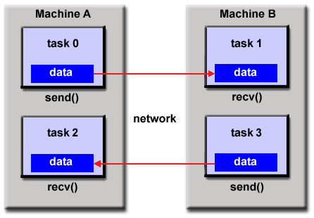
Message Passing Model

Slide 16
Message Passing Model - Implementations
From a programming perspective, message passing implementations commonly comprise a library of subroutines that are imbedded in source code. The programmer is responsible for determining all parallelism.
Historically, a variety of message passing libraries have been available since the 1980s. These implementations differed substantially from each other making it difficult for programmers to develop portable applications.
In 1992, the MPI Forum was formed with the primary goal of establishing a standard interface for message passing implementations.

Slide 17
Message Passing Model - Implementations
Part 1 of the Message Passing Interface (MPI) was released in 1994. Part 2 (MPI-2) was released in 1996. Both MPI specifications are available on the web at http://www-unix.mcs.anl.gov/mpi/.
MPI is now the "de facto" industry standard for message passing, replacing virtually all other message passing implementations used for production work. Most, if not all of the popular parallel computing platforms offer at least one implementation of MPI. A few offer a full implementation of MPI-2.
For shared memory architectures, MPI implementations usually don't use a network for task communications. Instead, they use shared memory (memory copies) for performance reasons.

Slide 18
Data Parallel Model
The data parallel model demonstrates the following characteristics:
Most of the parallel work focuses on performing operations on a data set. The data set is typically organized into a common structure, such as an array or cube.
A set of tasks work collectively on the same data structure, however, each task works on a different partition of the same data structure.
Tasks perform the same operation on their partition of work, for example, "add 4 to every array element".

Slide 19
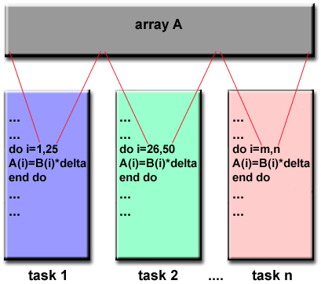
Data Parallel Model

Slide 20
Data Parallel Model - Implementations
Programming with the data parallel model is usually accomplished by writing a program with data parallel constructs. The constructs can be calls to a data parallel subroutine library or, compiler directives recognized by a data parallel compiler.
Fortran 90 and 95 (F90, F95): ISO/ANSI standard extensions to Fortran 77.Contains everything that is in Fortran 77
New source code format; additions to character set
Additions to program structure and commands
Variable additions - methods and arguments
Pointers and dynamic memory allocation added
Array processing (arrays treated as objects) added
Recursive and new intrinsic functions added
Many other new features

Slide 21
Data Parallel Model - Implementations
High Performance Fortran (HPF): Extensions to Fortran 90 to support data parallel programming.
Contains everything in Fortran 90
Directives to tell compiler how to distribute data added
Assertions that can improve optimization of generated code added
Data parallel constructs added (now part of Fortran 95)
HPF compilers were common in the 1990s, but are no longer commonly implemented.

Slide 22
Data Parallel Model - Implementations
Compiler Directives: Allow the programmer to specify the distribution and alignment of data. Fortran implementations are available for most common parallel platforms.
Distributed memory implementations of this model usually have the compiler convert the program into standard code with calls to a message passing library (MPI usually) to distribute the data to all the processes. All message passing is done invisibly to the programmer.

